Slide 1

Dialog State Tracking Challenge II
Wencan Luo
12/06/2013
http://camdial.org/~mh521/dstc/

Slide 2
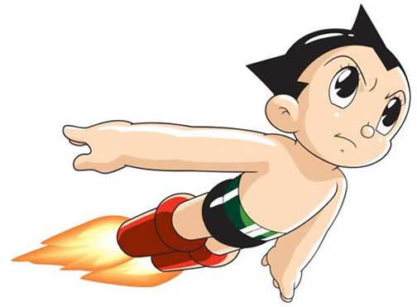
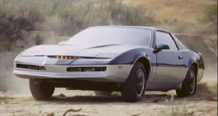

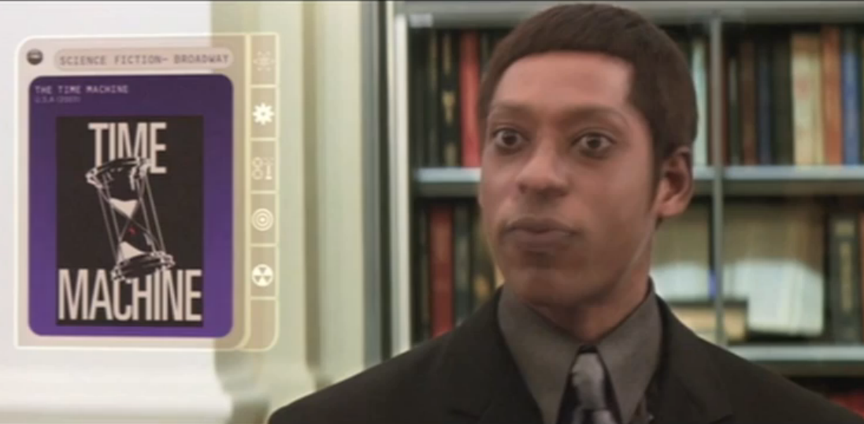

Motivation: Fiction
Astro Boy (1952)
KITT (Knight Rider) (1982)
HAL 9000 (2001)
Time Machine Librarian (2002)
WALL.E (2008)

Slide 3
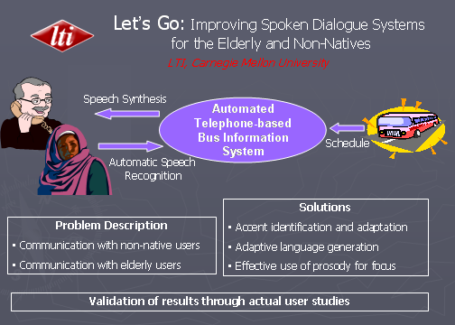
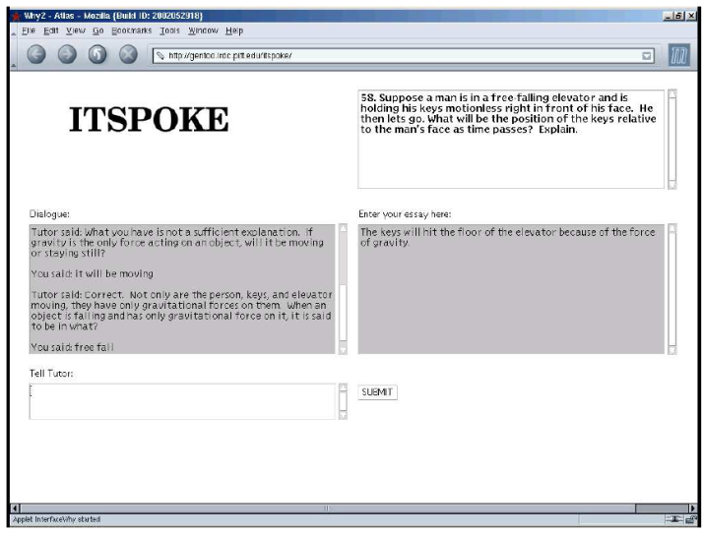
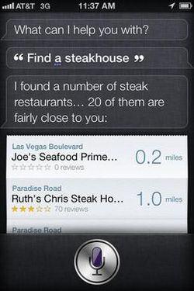
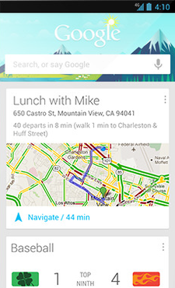
Motivation: from Fiction to Facts
2003
2004
2011
2012

Slide 4
Challenges: every transition is not perfect
ASR
Automatic Speech Recognizer
NLU/SLU
Natural Language Understanding
DM
Dialogue Manager
DM
Dialogue Manager
TM
Task Manager
NLG
Natural Language Generation
TTS
Text-to-Speech

Slide 5
Dialog State Tracking: from Open-loop to Close-loop
Dialog State Tracking
ASR
Automatic Speech Recognizer
NLU/SLU
Natural Language Understanding
DM
Dialogue Manager
DM
Dialogue Manager
TM
Task Manager
NLG
Natural Language Generation
TTS
Text-to-Speech

Slide 6
Dialog State Tracking Challenge (DSTC) Overview
Test bank for comparing different approaches
Challenge 1 (finished)
Corpus: CMU, “Let’s Go” (Bus timetables)
9 teams, 27 submission
Results are in Sigdial 2013
No winer
Challenge 2 & 3
New Corpus: Restaurant (from University of Cambridge)

Slide 7
Challenge 2 Schedule
7th October 2013 Train and development set released
20th January 2014 Unlabelled restaurant information test set released
27th January 2014 Tracker output on restaurant information test set due
3rd February 2014 Results on test set given to participants
5th March 2014 Approximate SIGdial deadline
June 2014 Results presented at SIGDIAL Conference

Slide 8
Corpus: An Example
Hello , welcome to the Cambridge restaurant system? You can ask for restaurants by area , price range or food type . How may I help you?
hello and welcome to the cambridge
What kind of food would you like?
moderately priced swedish food
Sorry there is no swedish restaurant in the moderate price range
how about asian oriental
yippee noodle bar is a great restaurant serving asian oriental food and it is in the moderate price range
is there anything else
Can I help you with anything else?
could i have the address and phone number
Sure , yippee noodle bar is on 40428 King Street City Centre
phone number
The phone number of yippee noodle bar is 01223 518111 .
thank you good bye

Slide 9
Comprehensive Log Data
What kind of food would you like?
start-time: 2.36377 end-time: 4.79
dialog-acts: request(food)
moderately priced swedish food
"asr-hyp": [ "moderately priced swedish food“, score=-0.011239;
"moderately priced swiss food", score=-5.548622;
….
]
"slu-hyp" : [inform(food=swedish), inform(pricerange=moderate), score=0.607;
inform(food=swiss), score=0.1;
….
]
could i have the address and phone number
"slu-hyp“: [request(slot=addr), score= 0.728;
request(slot=addr), request(slot=phone), score=0.272
]

Slide 10
3 Dialog States
Close-Domain
Dialog States |  | number of values | value examples
Goals | area | 5 | centre,north,west,south,east
 | food | 91 | catalan,chinese,christmas,corsica,creative,crossover,cuban
 | name | 113 | ali baba,anatolia,ask,backstreet bistro,bangkok city,bedouin
 | pricerange | 3 | cheap,moderate,expensive
Method |  | 4 | none,byconstraints,byname,finished,byalternatives
Request |  | 8 | addr,area,food,phone,pricerange,postcode,signature,name

Slide 11
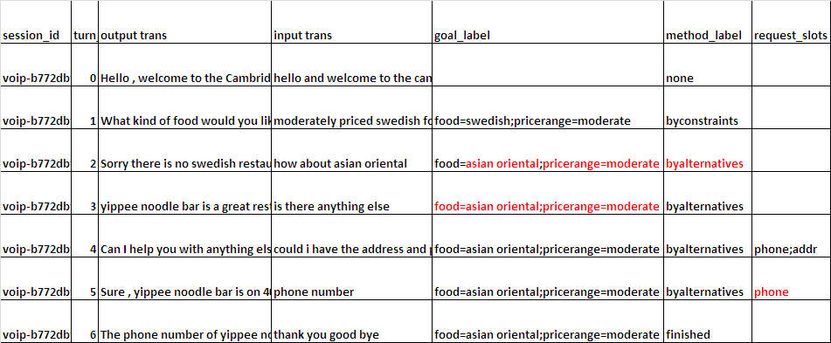
Accumulated Annotation

Slide 12
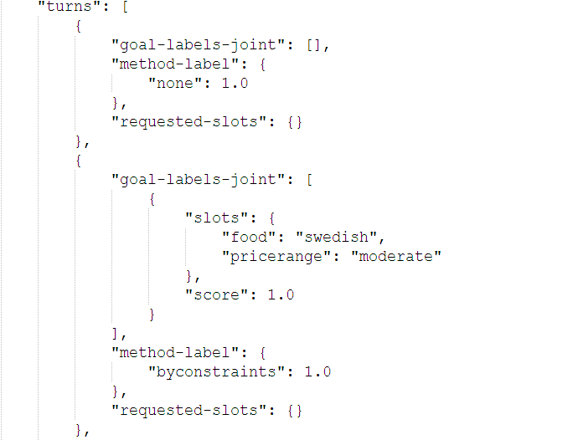
Task: Tracking the 3 States (an example output)

Slide 13
Evaluation Metrics
Accuracy
Ratio of the 1-best correct hypothesis.
L2
The L2 norm between the vector of correct scores and the result
ROC
Aim to evaluate how "discriminative" is for the top hypothesis

Slide 14
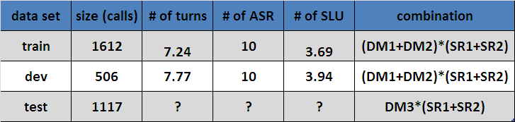
Basic Info about the Corpus
*DM (Dialog Manager)
*SR (Speech Recognizer)

Slide 15
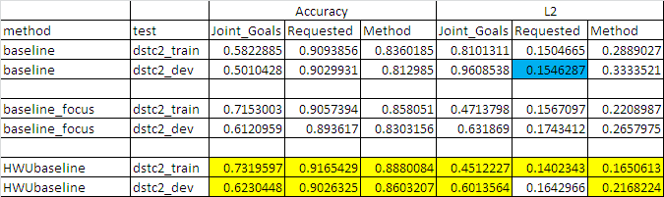

Three Baselines
Baseline + Baseline_focus
HWU_Baseline
(Heriot-Watt University)

Slide 16
Our Current Approaches
First-Correct Model (best for “goals”)
Decompose the problem
Request Classifier (best for “request”)
Method Classifier (best for “method”)
Goals Classifier

Slide 17


First-Correct Model
Considering only the top 1 is not enough
Considering only the first-correct one
SLU 1
SLU 2
SLU 3

Slide 18
Missing Gold-standard
Assumptions: the SLU is correct if and only if:
H1: all the SLU hyps (slot,value) appear in the annotation
H2: it matches the differences between the pervious correct answer and the current one
H3: it will turn into the correct answer based on the previous one and the new SLU
H1 is the best

Slide 19
SLU Classifier
Features
Dialog Acts (21)
“inform”, “request”, “reqalts”, “affirm”, “negate”, …
Top ASR Unigram (577)
“moderately priced swedish food”
3 different training sets
“All SLU Candidates”
“Top 3 SLU Candidates”
“Top 1 SLU Candidates”

Slide 20
First Correct Model Result
HWUBaseline > Top1 > Top3 > All
Picking up top ASR for all SLU might not be good

Slide 21
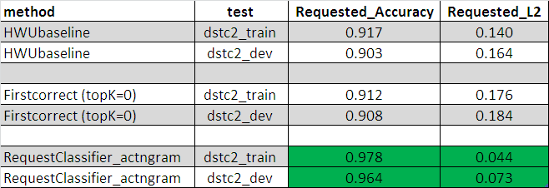
Decompose the Problem: Request Classifier
Only 8 things are “requestable”
addr, area, food, phone, pricerange, postcode, signature, name
Build 8 binary classifiers
Build a new model for “request”: ASR -> Goal
Consider the ASR errors
“phone number” -> “i don't the number”

Slide 22
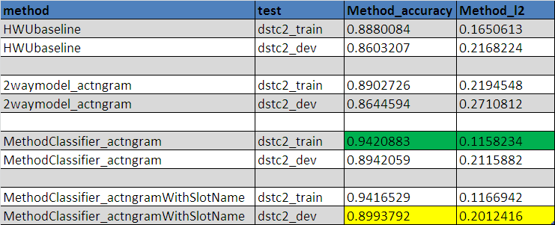
Method Classifier
Only 5 possible values
none,byconstraints,byname,finished,byalternatives
New Feature Set
Slot with name (“inform” -> “inform(food)”)

Slide 23
Goals Classifier
4 Slots
Area (5): centre,north,west,south,east
Food (91)
Name (113)
Pricerange (3): cheap,moderate,expensive
Two-stage Classifiers
1) Binary (Yes, No)
2a) For “area” and “pricerange”, another classifier
2b) For “food” and “name”
if “Yes”, find the first slot-value in SLU
Not better than the first-correct model

Slide 24
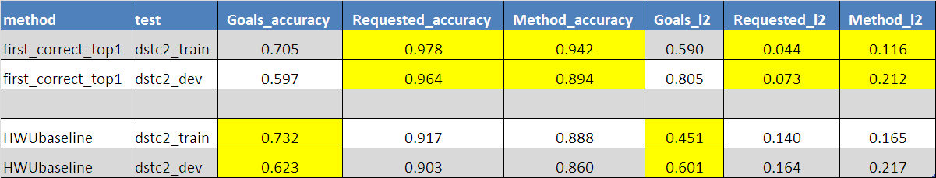
Current Best Results
Goals: first correct model with training on top1
Request: request classifier
Method: method classifier

Slide 25
Other Interesting Results: Toplines
Topline1: SLU
Topline2: Top ASR
Topline 3: Transcription

Slide 26

Need Your Feedback!!

